Slide 1
20 yoga poses you need to know

Slide 2
In this presentation, you will become familiar with 20 of the traditional yoga poses we have performed in class.
1. BOAT 11. LORD OF THE DANCE
2. BOW 12. ONE LEGGED DOWNWARD DOG
3. BRIDGE 13. REVERSE TRIANGLE
4. CAT 14. REVERSE WARRIOR
5. CHAIR 15. TREE
6. CHILD’S POSE 16. TRIANGLE
7. COBRA 17. UPWARD FACING DOG
8. COW 18. WARRIOR 1
9.. DOLPHIN 19. WARRIOR 2
10. DOWNWARD DOG 20. WARRIOR 3

Slide 3
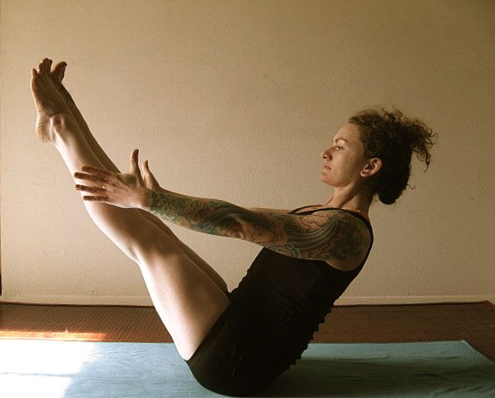
BOAT

Slide 4
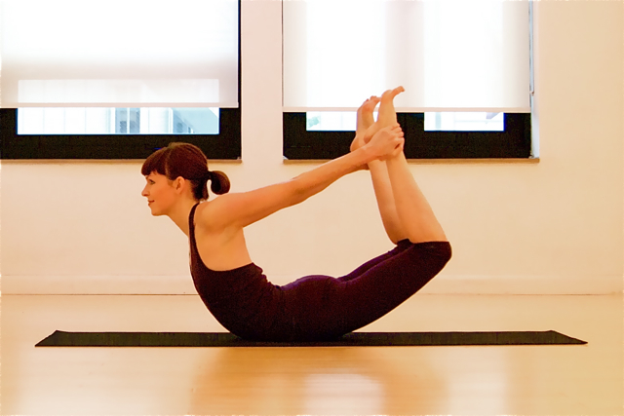
BOW

Slide 5
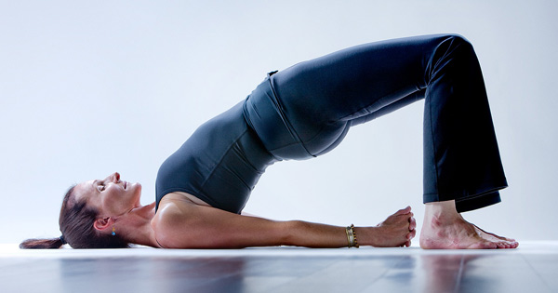
BRIDGE

Slide 6
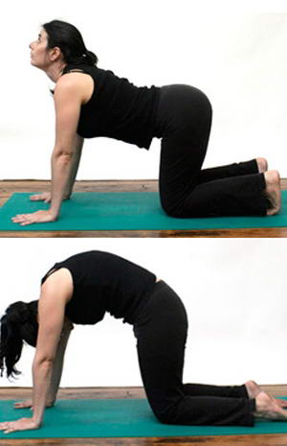
CAT

Slide 7
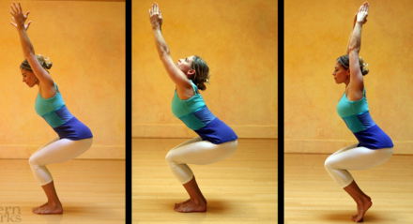
CHAIR POSE

Slide 8
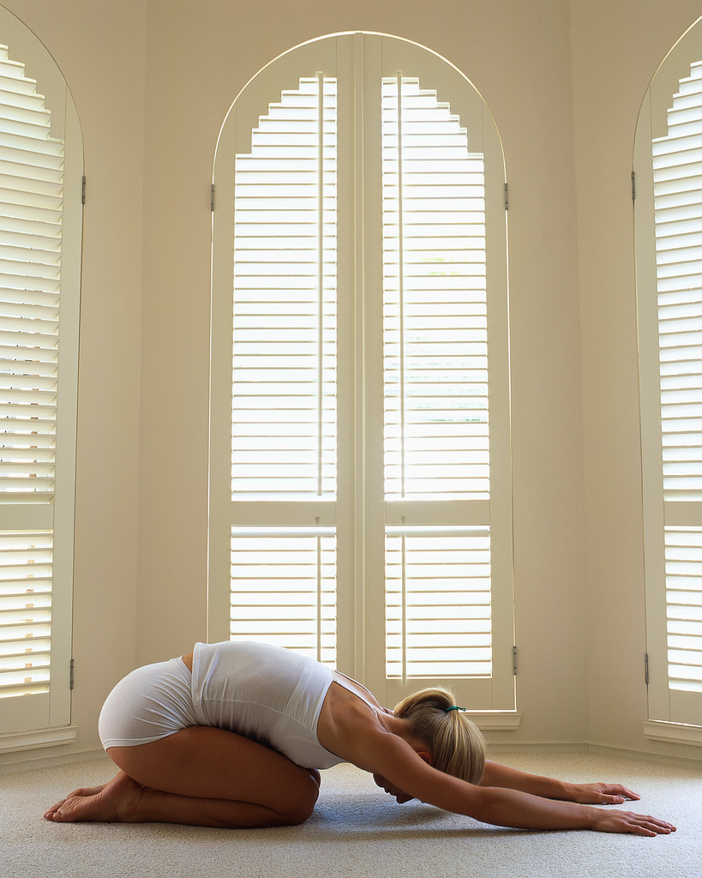
CHILD’S POSE

Slide 9
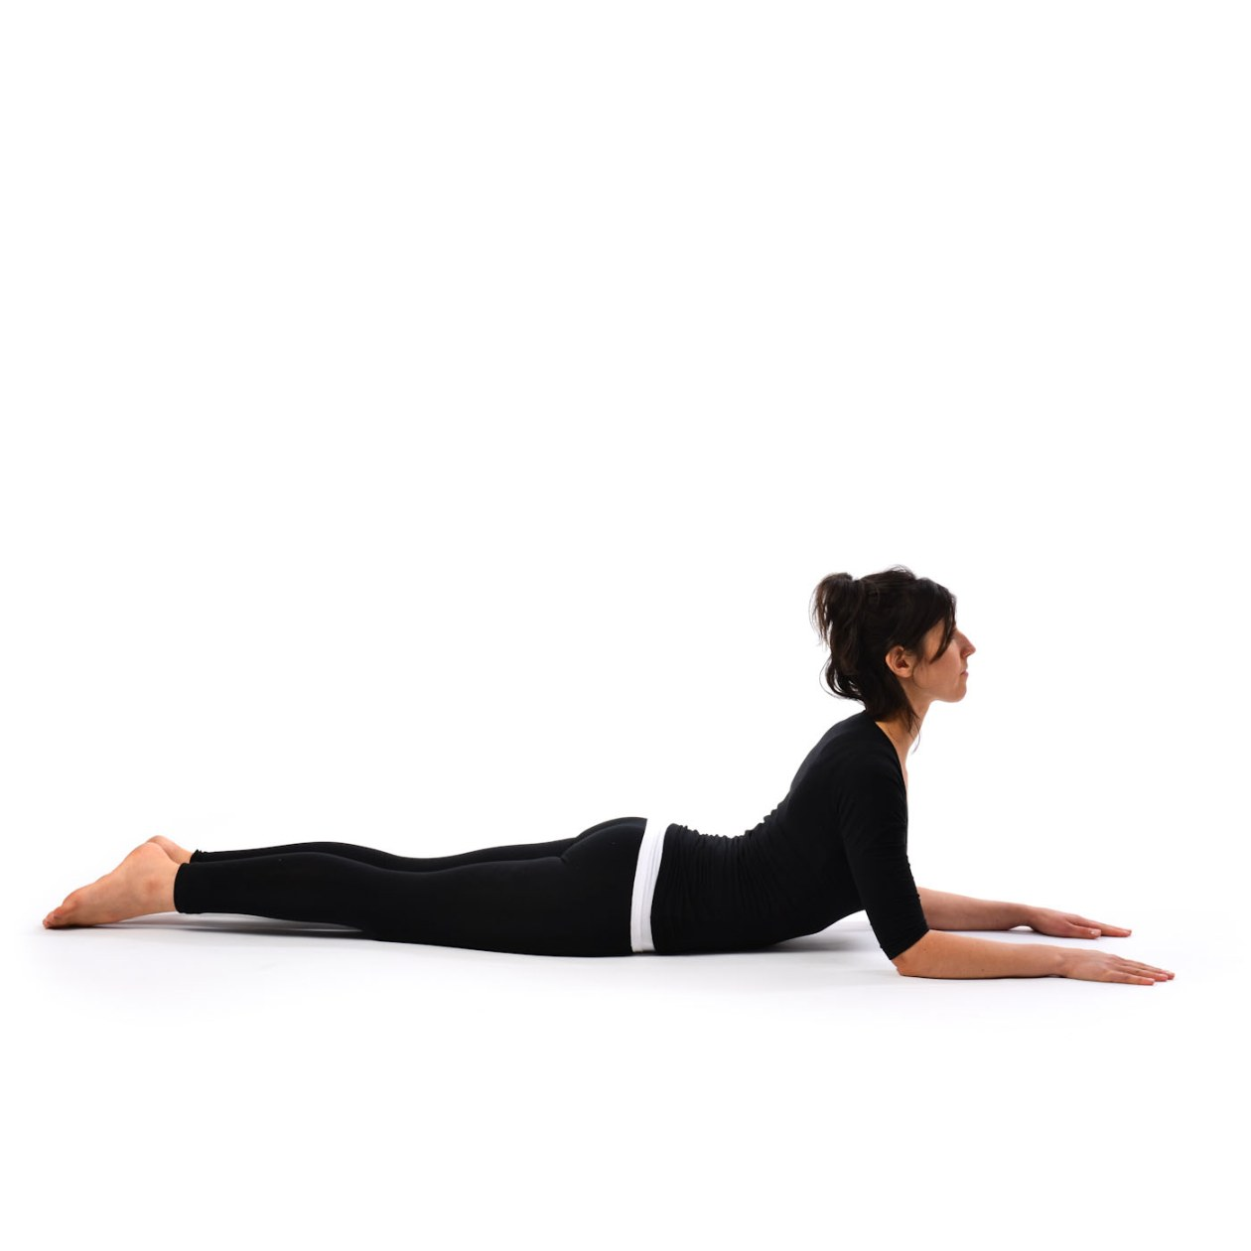
COBRA

Slide 10
COW

Slide 11
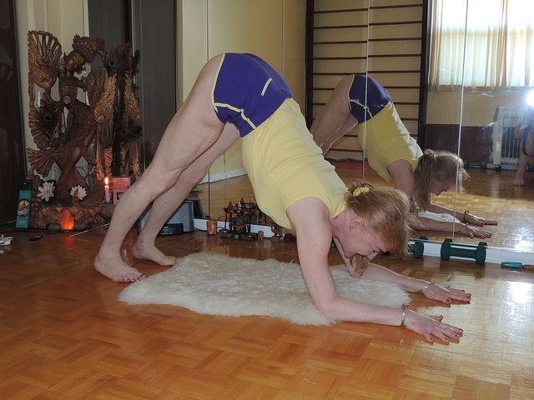
DOLPHIN

Slide 12
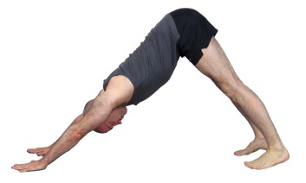
DOWNWARD DOG

Slide 13
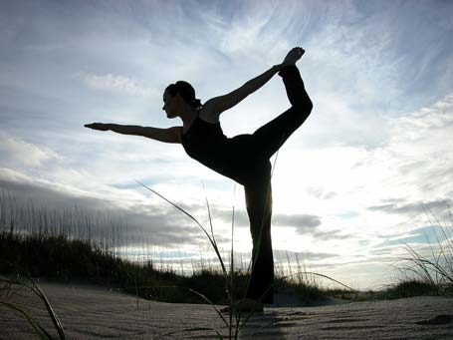
LORD OF THE DANCE

Slide 14
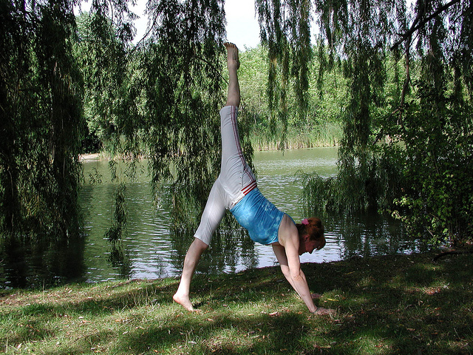
ONE LEGGED DOWNWARD DOG

Slide 15
REVERSE TRIANGLE

Slide 16
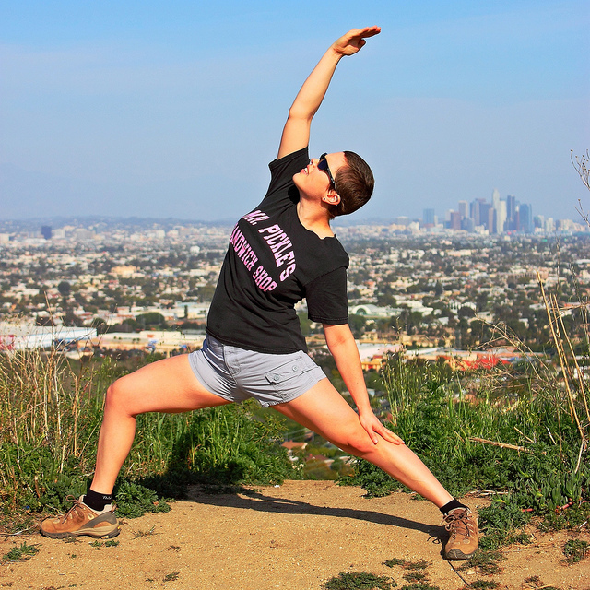
REVERSE WARRIOR

Slide 17
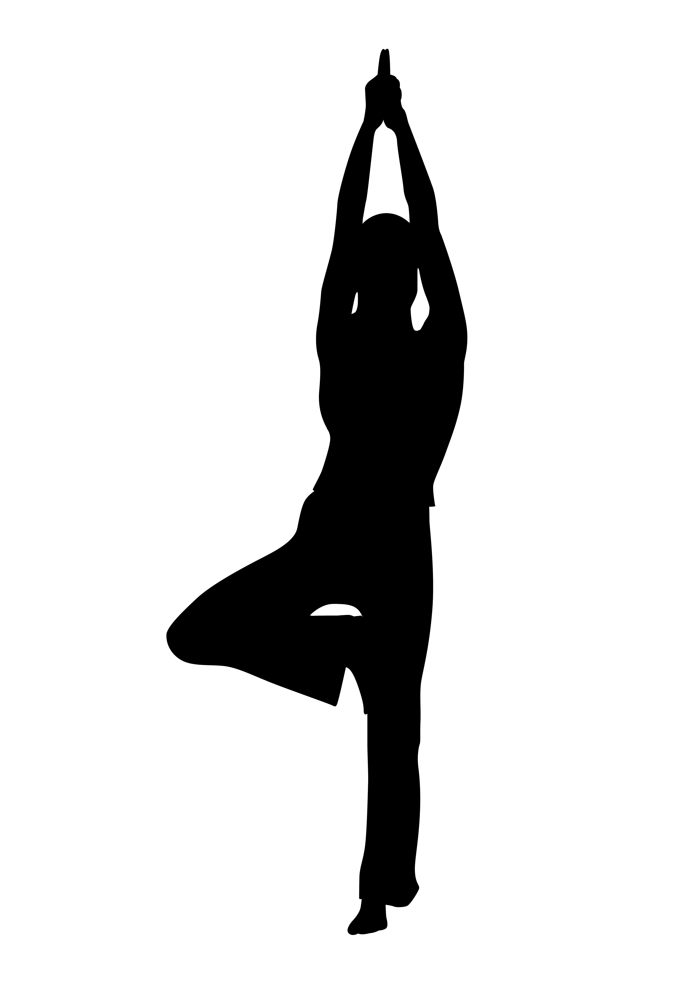
TREE

Slide 18
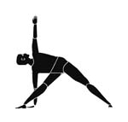
TRIANGLE

Slide 19
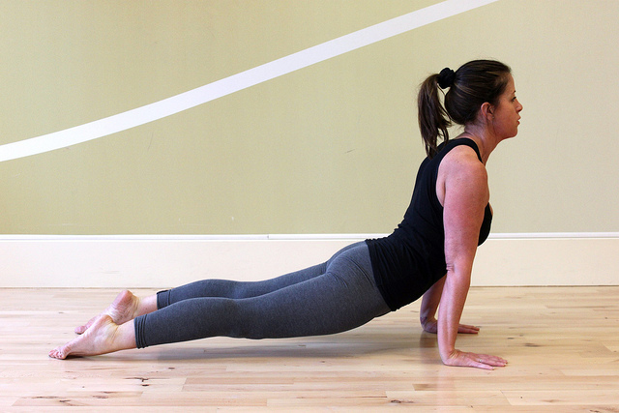
UPWARD FACING DOG

Slide 20
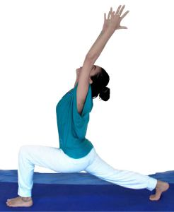
WARRIOR 1

Slide 21
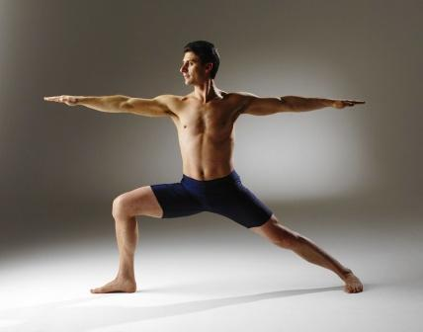
WARRIOR 2

Slide 22
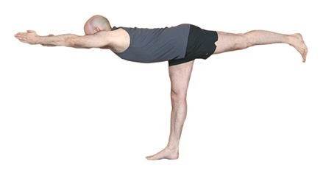
WARRIOR 3

